Slide 1

Analysis of univariate random variables Workshop 1
Irina Deeva
Teaching Assistant, Researcher

Slide 2
Key points
Univariate random variable
Discrete and continuous random variable
Distribution of random variable
Distribution parameters estimation
Sample mean and variance
Kernel density estimation

Slide 3
Learning objectives
Students will be able to give examples of one-dimensional random variables.
Students will be able to distinguish at least three differences between discrete random variables from continuous ones.
Students will be able to give examples of discrete random variables and continuous.
Students will be able to estimate (calculate) parameters of one-dimensional distributions.
Students will be able to write Python code that estimates (calculates) the sample mean, deviation, and confidence intervals of a one-dimensional random variable, and draws a kernel estimate for that random variable.

Slide 4

Revising basics
Follow the link https://forms.gle/ARrBr3MZTXDuSUyR6
Fill in the first and last name and then answer the questions
This is an individual work. You have 5 minutes

Slide 5
Random variables

Slide 6
Random variable
Discrete random variable – a variable that can take on only
specific values or countable set of values
Probability law – it is relation between certain value of random variable and it’s probability
Examples of discrete probability distributions:
- Binomial probability distribution
- Hypergeometric probability distribution
- Multinomial probability distribution
- Negative binomial distribution
- Poisson probability distribution

Slide 7
Random variable
Continuous random variable - a variable that can take on any value in a specified range
Probability distribution function (cumulative) – probability that random outcome takes on a value less than x
*
* Strictly speaking is defined for discrete random variables,
BUT
Distribution function properties (main):
1.
2.

Slide 8
Practice
Could you give me examples of discrete random variables and continuous ones from the real life?
Discrete random variable | Continuous random variable
Gender | Temperature
… | …

Slide 9
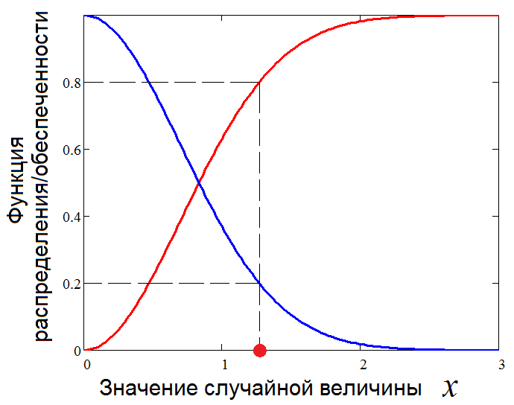
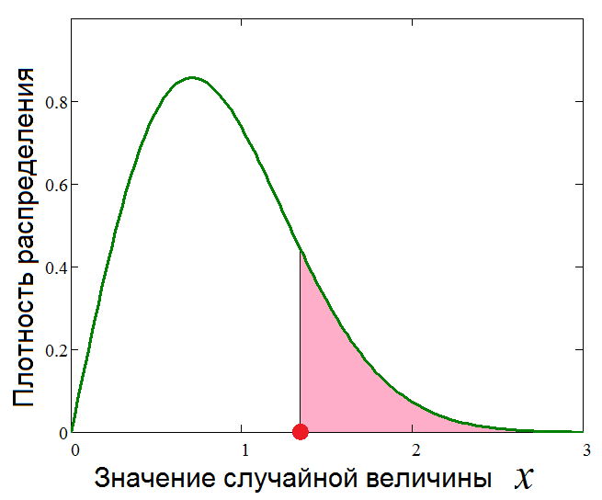



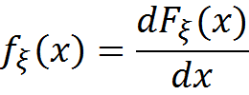

Function and distribution density
Distribution density​
p%
Сumulative distribution function (CDF)
1-p%
Random value x
Random value x
p%-quantile :
Distribution density:

Slide 10


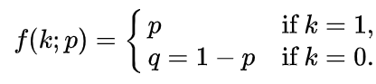
Useful model: categorical distribution
A categorical (multi-nomial) distribution is a generalized probability distribution of categories (k > 2) or discrete random value.
If there are only two categories k, the multi-nomial distribution - > Bernoulli distribution:
Why it is so important?
Plays an important role in the thematic analysis of texts in ML and NLP.

Slide 11
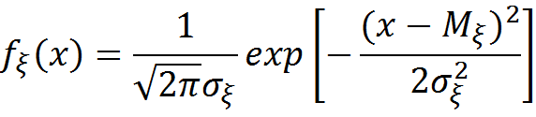
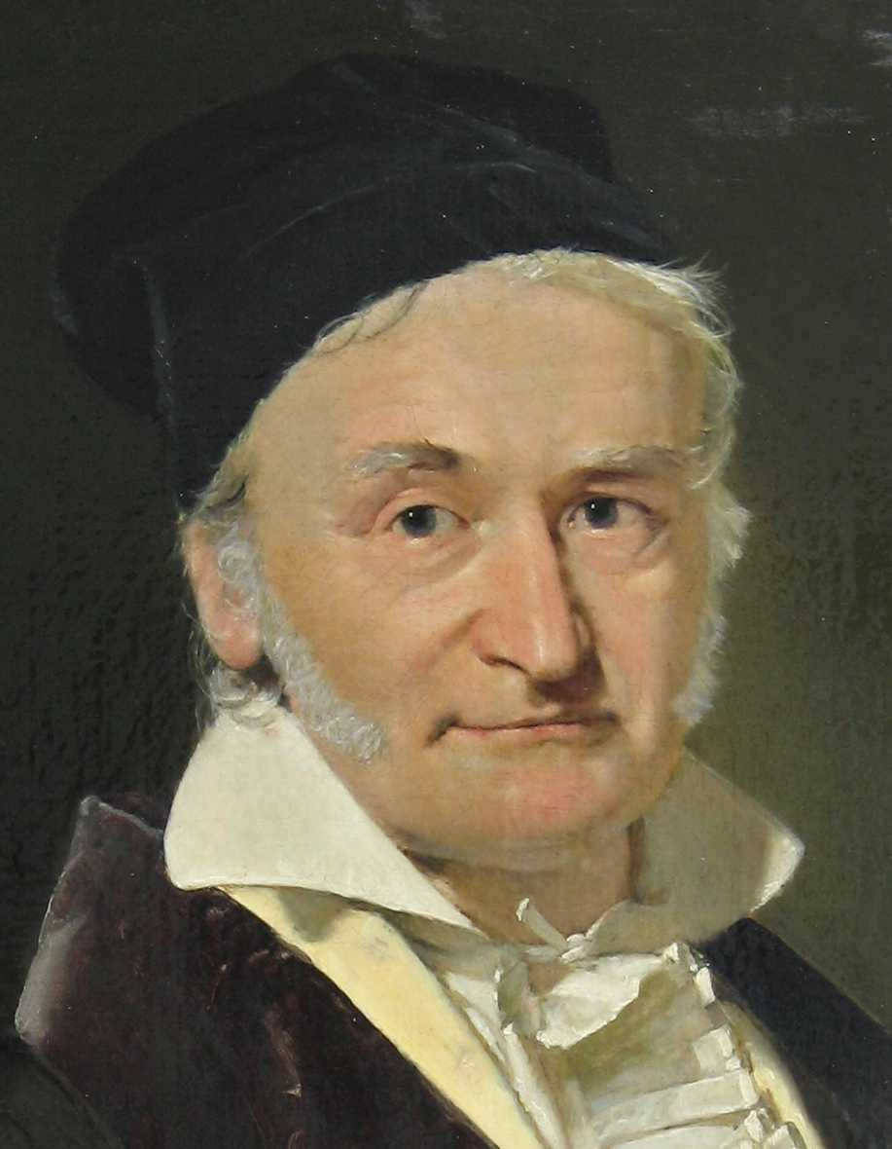

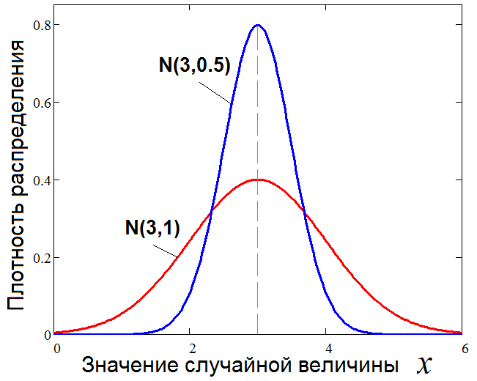

Useful model: Gaussian distribution
Distribution density:
Nomenaclature:
Calculation of p%-quantile for Gaussian distribution:
Distribution density​
Why it is so important?
The mixture of Gaussian distributions is a universal approximation for any smooth density function.
Random value x

Slide 12
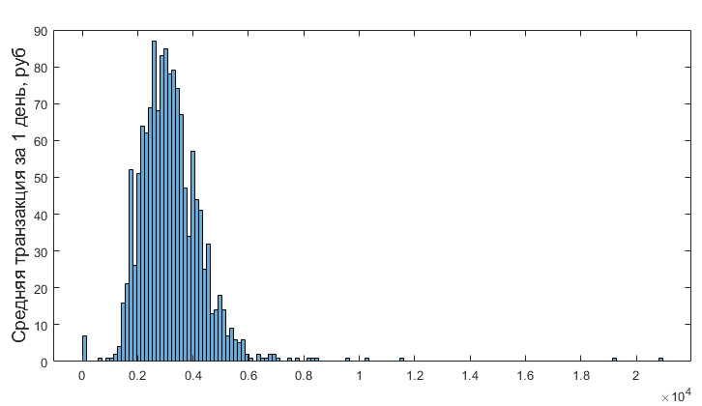

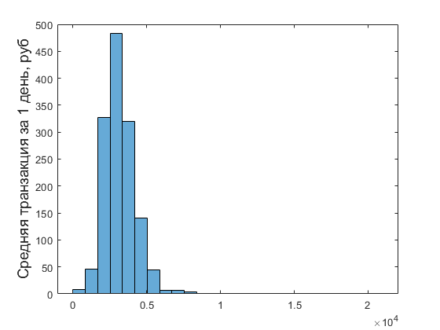



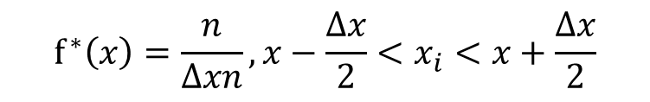
Nonparamteriс distribution estimators (1/2)
Histogram as way to display frequency characteristics of random values:
Secondary modes
$$f^{∗}\left(x\right)=\frac{n}{Δxn}, x−\frac{Δx}{2}<x_{i}<x+\frac{Δx}{2}$$
Outliers
Outliers
Assessment of number (m) of histogram columns:
$$m=1+3.32\lg{n}$$
1)
1)"Smoothness"
2)Unimodality (almost always)
2)
$$m=5\lg{n}$$
3) Own choice

Slide 13
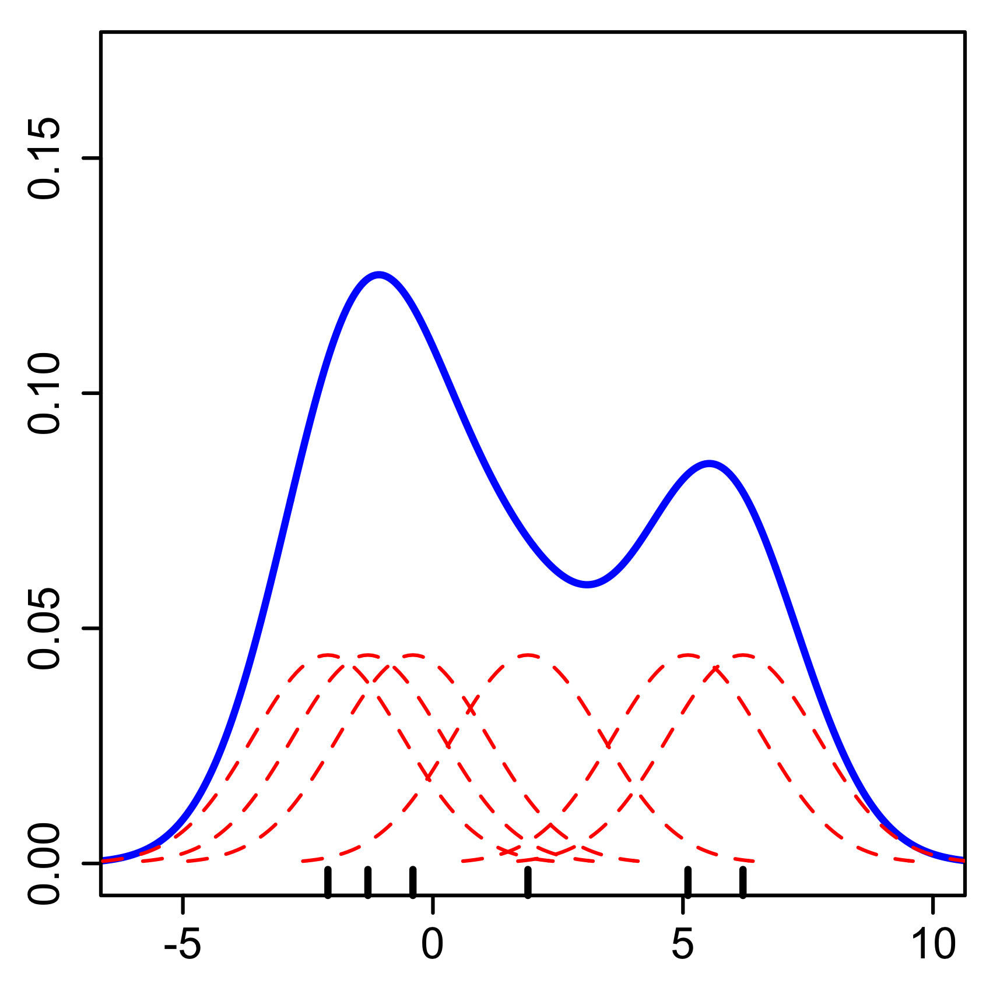
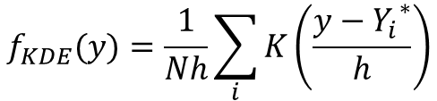


Nonparamteriс distribution estimators (2/2)
The kernel smoothing method is often applied for "smooth" estimates of distribution density.
Essence: replacement of the rectangular not crossed histogram columns with the sum of curves (functions) with the centers in sample data:
Kernel functions k
Sample data
Distribution density estimations
$$f_{KDE}(y)=\frac{1}{Nh}\sum_{i}{K\left(\frac{y−{Y_{i}}^{∗}}{h}\right)}$$
Smoothing parameter
Kenrel function
There is a lot of kernel functions, but usually Gaussian function is enough:
$${Y_{i}}^{∗}$$
Sample data
Width of a window (h) is selected empirically, but it is possible to estimate on a formula:
$$h= σ^{∗}N^{−0.2}$$

Slide 14

Example in Python
Open file Statistical Data Modeling.ipynb https://drive.google.com/drive/folders/1d6hf8bymtBtZnFvEF32Pu2jVm8xcr38H?usp=sharing
Follow teacher instructions and run parts of the program code with me

Slide 15

Estimation of probability model
Probabilistic definition
Statistical definition
High-order moments of probability distribution
High-order moments estimation
First raw moment point unbiased
estimation – mean value
If = 0
is a raw moment
If = M[X]
is a central moment
First raw moment – mathematical expectation
10/10/2022

Slide 16
Estimation of probability model
Probabilistic definition
Statistical definition
High-order moments of probability distribution
High-order moments estimation
Second central moment point biased estimation
Second central moment – variance
Second central moment point unbiased estimation
For big samples V*=V**
10/10/2022

Slide 17
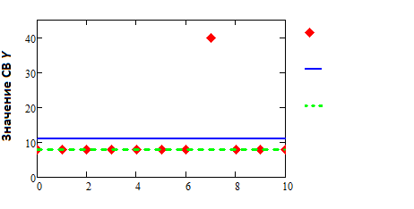

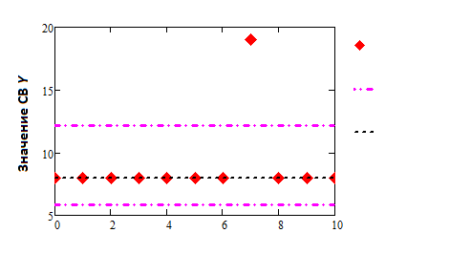


Robust estimation
Robust Central Trend Assessment:
Trimmed mean value ( α - percentage of sample members cut off)
$$− RV Y$$
$$− \overline{y}$$
Random Value Y
$${− \overline{y}}_{α}$$
Robust estimation of the deviation measure:
Mean Absolute Deviation (MAD-estimation)
$$− RV Y$$
$$− \overline{y}±s$$
For symmetrical distributions
Random Value Y
$$− \overline{y}±MAD$$

Slide 18
Interval estimates
Confidence interval is a particular case for probability interval for distribution function parameter estimates:
- Confidence interval is based on known distribution function for estimate of parameter.
- Confidence interval range can vary from sample to sample due to its size.
- Confidence interval can be built using known and unknown parameters
where α is significance level, (1-α) is a confidence level.
The higher the confidence level, the wider bounds of confidence interval.

Slide 19
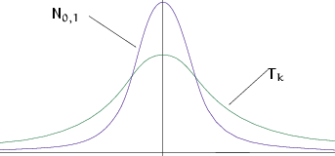
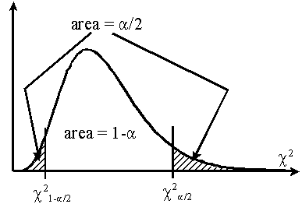
Interval estimates
Confidence interval for mean (σ is a sample estimate):
Student distribution
Confidence interval for variance:
probability density:
Confidence interval for standard deviation:
10/10/2022

Slide 20
Example in Python
Open file Task1-2.ipynb https://drive.google.com/drive/folders/1d6hf8bymtBtZnFvEF32Pu2jVm8xcr38H?usp=sharing
Follow teacher instructions and run parts of the program code with me

Slide 21
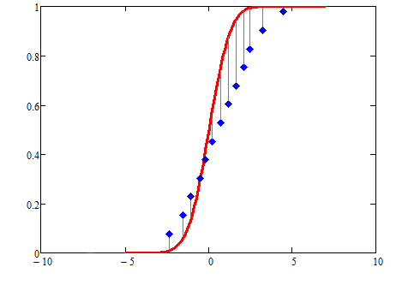






Kolmogorov test
Estimated statistic:
Goodness of fit testing
Theoretical distribution
Test (rejection of ):
Maximal difference
- quantile of Kolmogorov distribution
H0 - The data follow a specified distribution
Pvalue < α - reject

Slide 22
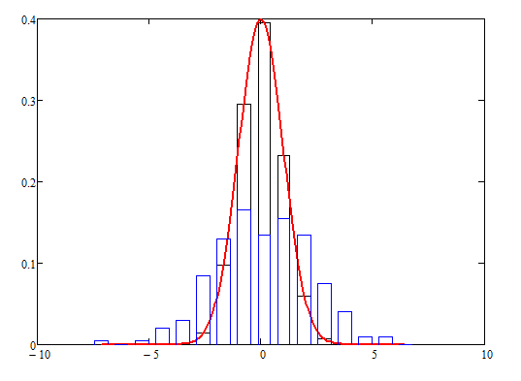

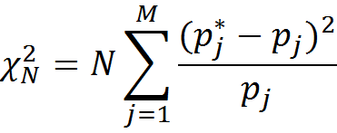




Pearson’s test
Estimated statistic:
Goodness of fit testing for grouped data
$${χ_{k}}^{2}=n\sum_{i}{\frac{{d_{i}}^{2}}{p_{i}}}$$
$$d_{i}$$
Test (rejection of ):
Random variable x
- quantile of distribution

Slide 23
Example in Python
Open file Task3-4.ipynb https://drive.google.com/drive/folders/1d6hf8bymtBtZnFvEF32Pu2jVm8xcr38H?usp=sharing
Follow teacher instructions and run parts of the program code with me

Slide 24
Lab1
NOTE. For this lab you need subsample with 3-5 random variables, at least half of them should be described with continuous random variable type.
Step 1. Choose subsample with main variables for your further analysis. Then for each of them:
Step 2. You need to make a non-parametric estimation of PDF in form of histogram and using kernel density function (or probability law in case of discrete RV).
Step 3. You need to make an estimation of order statistics and represent them as “box with whiskers” plot.
Step 4. Find one or several theoretical distributions that could describe your sample on a basis of non-parametric analysis results.
Step 5. Estimate parameters of chosen distributions using methods of maximum likelihood and least squares method.
Step 6. Validate your estimated parameters using QQ biplots.
Step 7. Estimate correctness of fitted distributions using at least 2 statistical tests.

